Slide 1



VISVESVARAYA TECHNOLOGICAL UNIVERSITY BELAGAVI, KARNATAKA
BILURU GURUBASAVA MAHASWAMIJI INSTITUTE OF TECHNOLOFY MUDHOL
(Affiliated to VTU, Approved by AICTE )
DEPARTMENT OF COMPUTER SCIENCE AND ENGINEERING
Project Phase 2 Presentation on
“Crowd Prediction for Bus lines using Artificial Intelligence”
Student Project Program-47th Series
(KSCST Reference No. 47S_BE_0343)
Under the guidance of,
Prof. Varun P. Sarvade
Assistant Professor
Department of Computer Science and Engineering
BGMIT MUDHOL
Team Members,
Gopal R. Chenni (2LB20CS005)
Pradnya S. Bilagi (2LB20CS015)
Dhanush J. Yadav(2LB20CS003)
Niranjan S. Purad (2LB20CS013)

Slide 2
Index
Abstract
Scope and Objective
Introduction
Literature Survey
Methodology
Tools Required
Result Analysis
Conclusion
References

Slide 3
ABSTRACT
Inefficient crowd prediction in bus lines leads to overcrowding, long wait times, missed connections, and suboptimal resource allocation. This hinders passenger satisfaction, service reliability, and overall public transportation efficiency. In current scenario, the Bus stand controllers maintain a bus routine manual and they don’t posses any software for this maintenance. The proposed work aims to provide solution for controllers, passengers and also public transportation owners a better way for handling the crowd, and optimize fuel consumption. The proposed work also aims to improve travel experience, reduce waiting times, improve operational efficiency, and reduced congestion

Slide 4
SCOPE AND OBJECTIVE
To improve public transportation efficiency and passenger experience by accurately predicting crowd levels on specific bus lines in real-time using artificial intelligence (AI).
Develop an AI model that can accurately predict the number of passengers on a bus at any given time and location.

Slide 5
INTRODUCTION
KSRTC(Karnataka State Road Transport Corporation) is one of the largest public transport corporations in India. As per KSRTC data for the month of December 2020, 12.93 lakh passengers travel per day and 40% buses have incurred miner and major accidents in the same month, and also KSRTC reported 2000 litters of fuel wastage per 2 to 4 kms.
Crowd prediction for bus lines utilizing artificial intelligence is a groundbreaking application that harnesses AI algorithms and data analytics to forecast and manage passenger loads and bus capacities. By amalgamating historical data, real-time information, and machine learning models, this technology aims to revolutionize the public transportation sector.
Through predictive analysis, AI algorithms can anticipate and project the volume of passengers at various bus stops or along specific routes at different times of the day.

Slide 6
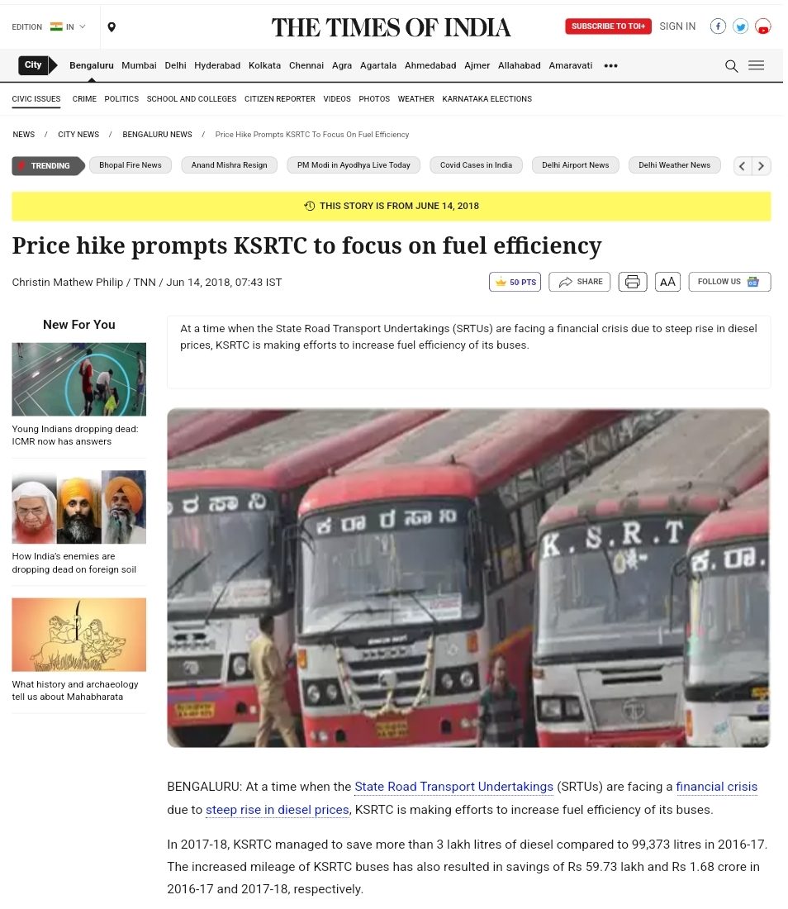
Figure 1: Screenshot of news article Price hike

Slide 7
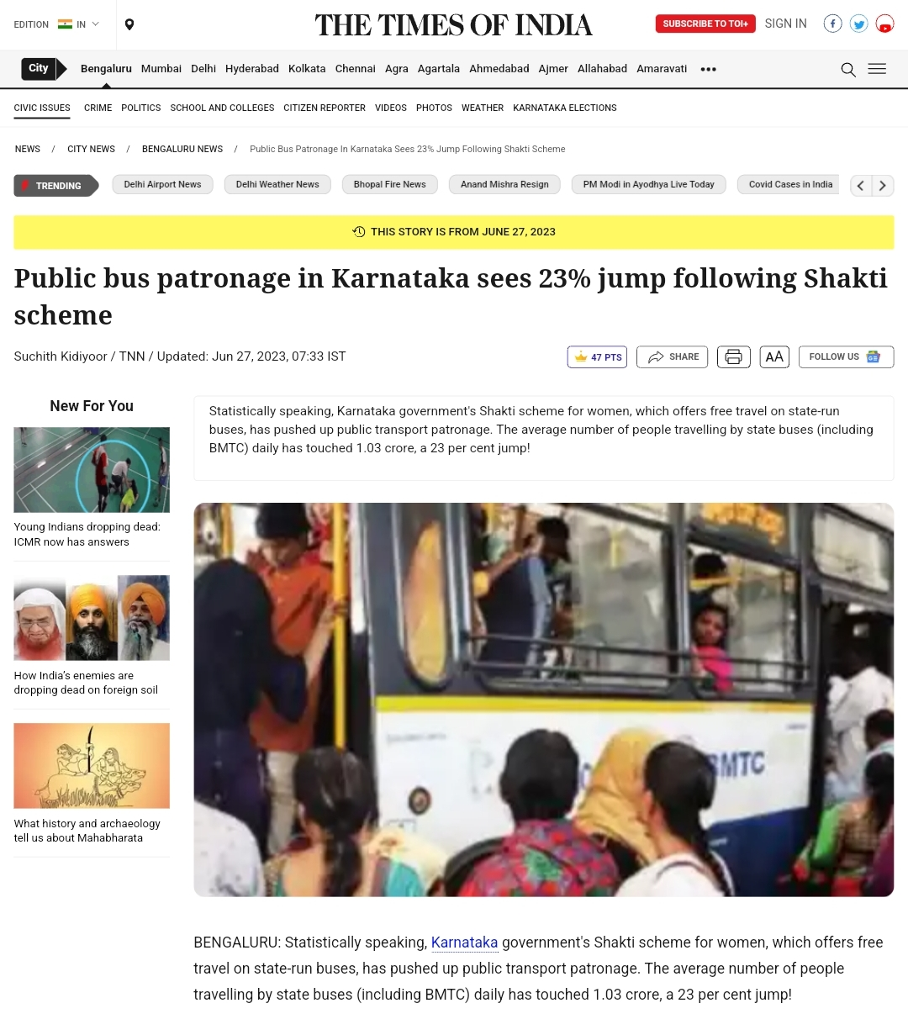
Figure 2: Screenshot of over crowding in buses

Slide 8
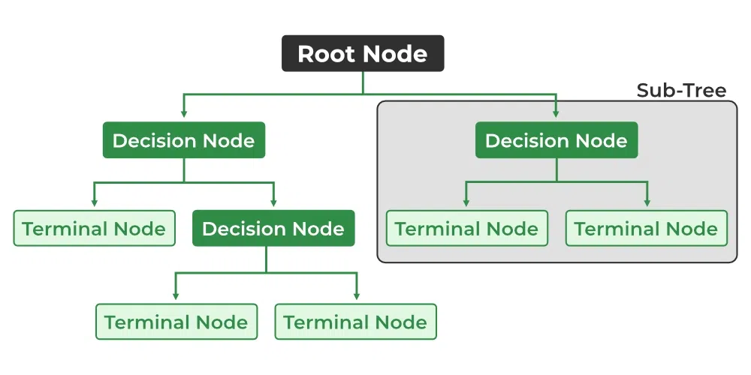
DECISION TREE
A decision tree is a flowchart-like tree structure where each internal node denotes the feature, branches denote the rules and the leaf nodes denote the result of the algorithm. It is a versatile supervised machine-learning algorithm, which is used for both classification and regression problems. It is one of the very powerful algorithms.
Figure: 3 Decision Tree

Slide 9
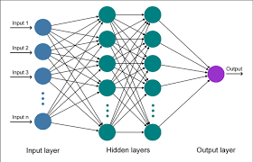
ARTIFICIAL NEURAL NETWORK
ANN stands for Artificial Neural Network, a computational model inspired by the biological neural networks present in animal brains. It's a fundamental concept in machine learning and has been widely used in various fields, including computer vision, natural language processing, and robotics.
Figure 4: ANN Model

Slide 10
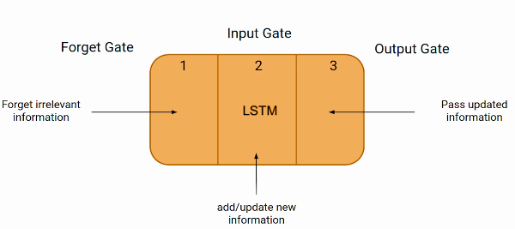
LONG SHORT TERM MEMORY
Long Short-Term Memory (LSTM) networks are a type of recurrent neural network (RNN) architecture, designed to capture long-term dependencies and address the vanishing gradient problem commonly encountered in traditional RNNs. LSTMs are widely used in sequential data tasks such as natural language processing, time series prediction, and speech recognition.
Figure 5: LSTM Model

Slide 11
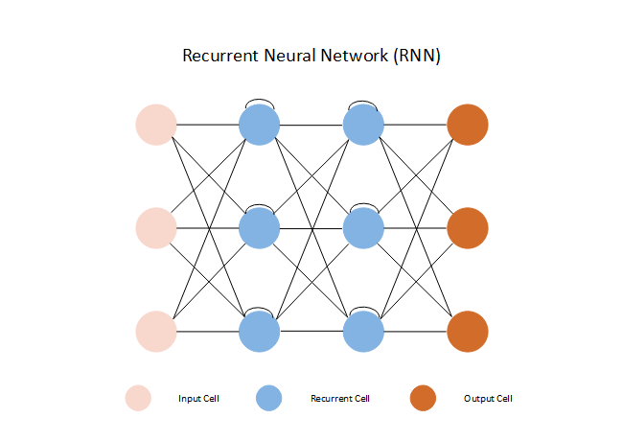
RECURRENT NEURAL NETWORK
Recurrent Neural Networks (RNNs) are a class of neural networks designed to handle sequential data by maintaining internal memory. They are widely used in tasks involving sequential input or output, such as time series prediction, natural language processing, and speech recognition.
The fundamental idea behind RNNs is to process sequences of inputs one element at a time while maintaining a hidden state that captures information about previous elements in the sequence
Figure 6: RNN Model

Slide 12
LITERATURE SURVEY
Si.no | Title of the paper | Author | Problem Identified | Methodology | Result Obtained | Remarks
01 | Bus arrival time prediction at bus stop with multiple route.[1] | Yu Bin, William H. K. Lam, and Mei Lam Tam | The main issue in predicting bus arrival times at stops with multiple routes lies in accurately accounting for varying schedules, potential delays, and route-specific factors, complicating precise time predictions for commuters. | Utilizing artificial neural networks to model and predict arrival times based on historical and real-time data | Improved accuracy in predicting bus arrival times at stops with multiple routes, potentially reducing waiting times for passengers | This paper investigated the bus arrival time prediction at bus stop with multiple routes
02 | A bus line planning framework for customized bus systems[2] | Yan Lyu, Chi-Yin Chow, Victor C. S. Lee, Joseph K. Y. Ng, Yanhua Li, and Jia Zeng. | a bus line planning framework for customized systems faces challenges in predicting demand accurately, optimizing routes efficiently, scheduling effectively, allocating resources wisely, ensuring a smooth passenger experience, and adapting to dynamic changes in urban environments and passenger needs. | Estimating and accounting for uncertainties in arrival times and passenger occupancies using probabilistic or statistical models. | Enhanced understanding and quantification of uncertainty in arrival time predictions and passenger occupancies, aiding in more informed decision-making | a holistic framework which aims to strategically plan bus lines for customized bus (CB) systems.

Slide 13
03 | Dynamic bus arrival time prediction with artificial neural networks [3] | Steven I-Jy Chien, Yuqing Ding, and Chienhung Wei | to predict the travel times of buses based on open data collected in real-time | Leveraging Google Maps or similar sources for insights into crowdedness trends and real-time crowd density estimation at transit locations | Insights into global crowdedness trends, offering a broader perspective on transit congestion patterns and potential solutions | Achieved increased accuracy in predicting arrival times, optimizing commuter waiting experience
04 | Estimating uncertainty of bus arrival times and passenger occupancies [4] | Vikash V. Gayah, Zhengyao Yu, Jonathan S. Wood | Focus on transit planning strategies considering multiple routes to optimize bus systems | Analyzing and understanding crowd dynamics within public transport systems to optimize services and alleviate congestion | Quantification and understanding of uncertainty in arrival time predictions and passenger counts, aiding in more robust decision-making processes | Acknowledged and quantified uncertainties, leading to more informed decision-making processes within transit management

Slide 14
05 | Transit crowdedness trends from around the world, according to Google Maps [5] | Taylah Hasaballah | Potential research on data integration methods or real-time data utilization for predicting arrival times more accurately | Utilizing image processing techniques for real-time estimation of crowd density in transit areas | Insights into global crowdedness trends in transit, offering comparative analyses and potential insights into managing congestion | Provided comprehensive insights into global transit congestion trends, highlighting areas for potential improvement in various regions.
06 | Crowding in public transport [6] | Zheng Li and David A. Hensher | Contribution could involve a comprehensive review or analysis of existing prediction models and methodologies | Implementing image processing for detecting crowd motion, motionless individuals, and estimating crowd densities specifically in subway environments | Specific insights into the dynamics and nature of crowds within public transport systems, potentially leading to strategies for alleviating congestion | Unveiled crucial insights into crowd dynamics within public transport systems, paving the way for strategic interventions to manage congestion effectively

Slide 15
07 | Real-time crowd density estimation using images [7] | Marana, AparecidoNilceu, Marcos Antonio Cavenaghi, Roberta SpolonUlson,and F.L.Drumond. | Likely research on system-wide improvements in public transportation, potentially exploring policy interventions or infrastructure enhancements | Employing computer vision methods to estimate the count of individuals within high-density crowd scenarios | Accurate estimation of the number of individuals within high-density crowd scenarios, assisting in crowd size estimation and planning. | Enabled real-time assessment and management of crowd densities at transit locations, fostering immediate responses to crowdedness
08 | Crowd motion estimation and motionless detection in subway corridors by image processing [8] | Bouchafa, Samia, Didier Aubert, and Salah Bouzar. | Might delve into innovative technologies or systems for dynamic routing and real-time updates to improve bus arrival time predictions | Implementing automated tools or algorithms for estimating crowd sizes, aiding in better understanding and management of transit congestion | Enhanced detection of crowd motion and stationary individuals within subway environments, contributing to efficient crowd control measures. | Improved understanding of crowd behavior within subway environments, facilitating better crowd control measures

Slide 16
09 | Human count estimation in high density crowd images and videos [9] | Chauhan, Vandit, Santosh Kumar, and Sanjay Kumar Singh | Possible exploration of user-centric approaches or passenger behavior analysis in arrival time prediction models. | Involves computer vision techniques to estimate the count of individuals within highly crowded scenarios using image or video data | Accurate estimation of headcounts within highly dense crowd scenarios, providing valuable data for crowd size estimation and management | Provided accurate estimates of crowd sizes, offering valuable data for crowd size prediction and management
10 | Automated Solutions for Crowd Size Estimation [10] | Muhammad Waqar Aziz1,2, Farhan Naeem3,Muhammad Hamad Alizai4, and Khan Bahadar Khan2 | Likely contributions on contextual factors affecting arrival time prediction, such as weather, traffic patterns, or geographical considerations. | Focuses on developing automated tools or algorithms to estimate crowd sizes in various transit settings, potentially aiding in crowd management strategies | Development of automated tools or algorithms specifically aimed at estimating crowd sizes, potentially facilitating quicker and more efficient crowd management strategies | Presented automated tools or algorithms for efficient crowd size estimation, potentially revolutionizing crowd management strategies

Slide 17
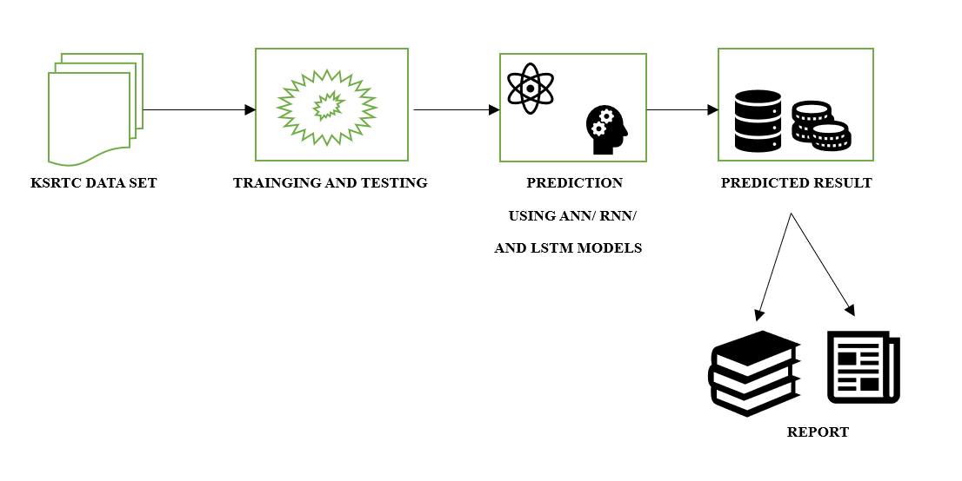
METHODOLOGY
A. BLOCK DIAGRAM
Figure 7: Block Diagram

Slide 18
Source | Destination | Trip | Route | Slot No | Adults | Childs | Revenue | Passenger count | Label
1 | 2 | 3 | 1 | 1 | 50 | 4 | 2589 | 54 | 1
1 | 4 | 3 | 1 | 1 | 50 | 10 | 3289 | 60 | 1
1 | 7 | 2 | 2 | 2 | 48 | 4 | 5478 | 52 | 0
1 | 13 | 2 | 3 | 3 | 49 | 7 | 5100 | 56 | 1
1 | 10 | 2 | 3 | 3 | 54 | 4 | 4989 | 58 | 1
1 | 3 | 21 | 2 | 2 | 50 | 12 | 3102 | 62 | 1
1 | 14 | 1 | 8 | 2 | 47 | 1 | 21000 | 48 | 0
Figure 8: Data Set
In this Data set has Source, Destination, Trip, Route Slot no, Adults, Childs, Revenue, Passenger Count and Label.

Slide 19
TOOLS REQUIRED
Python
Google Colab
Visualization tools like bar charts, histograms, box plots etc.

Slide 20
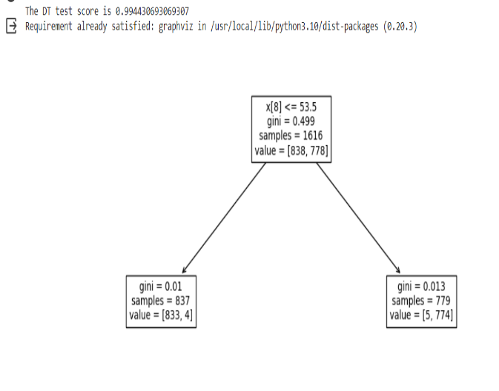
RESULT ANALYSIS
Results Using DECISION TREE MODEL
Figure 9: Decision Tree Accuracy

Slide 21
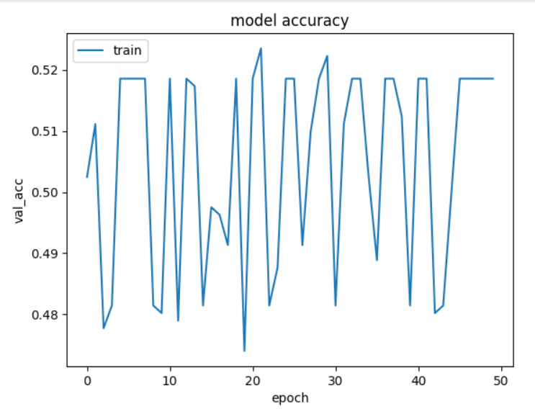
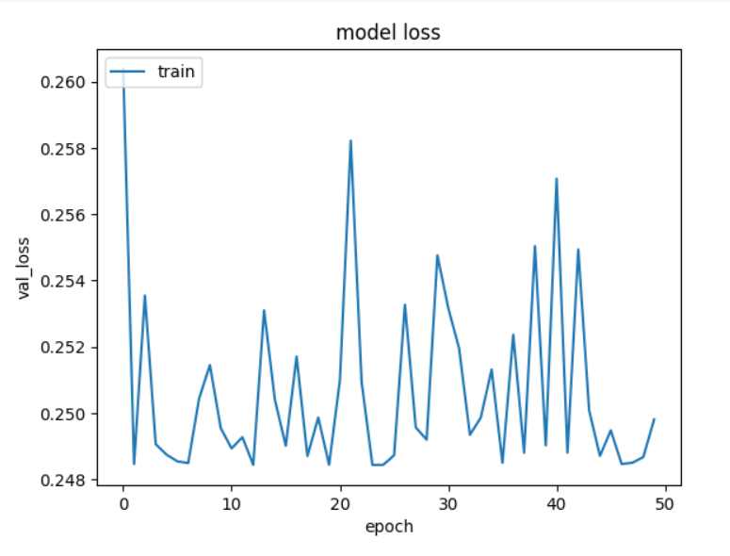
Results using ANN Model
Figure 10: Epoch v/s Model Accuracy
Figure 11: Epoch v/s Model Loss

Slide 22
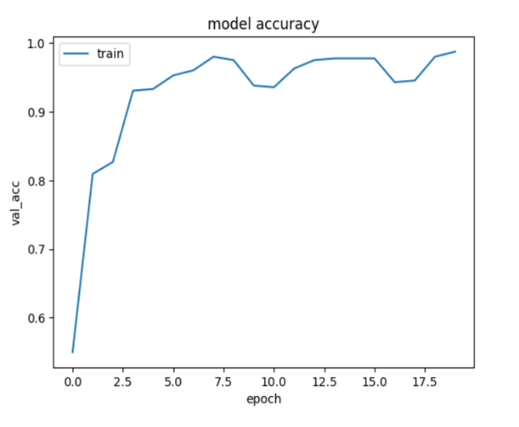
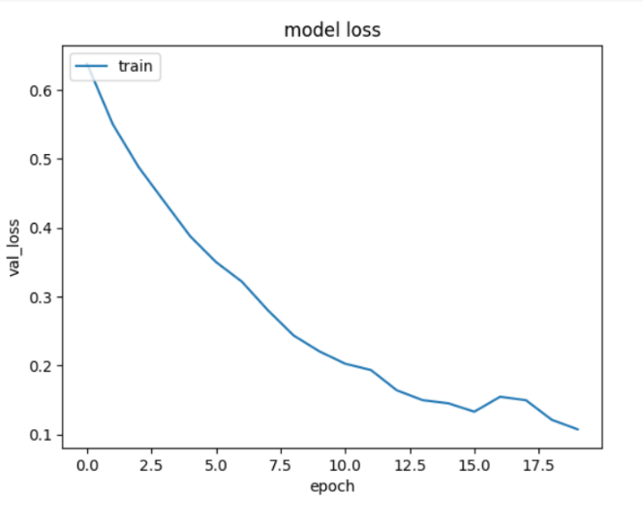
Results using LSTM Model
Figure 12: Epoch v/s Model Accuracy
Figure 13: Epoch v/s Model Loss

Slide 23
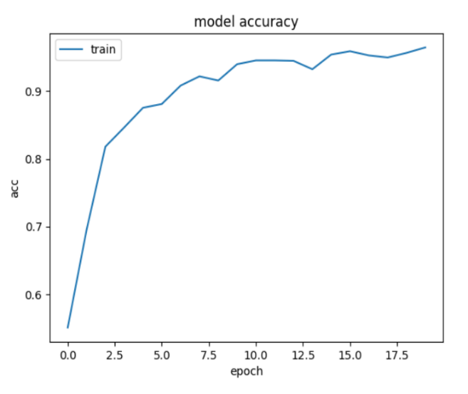
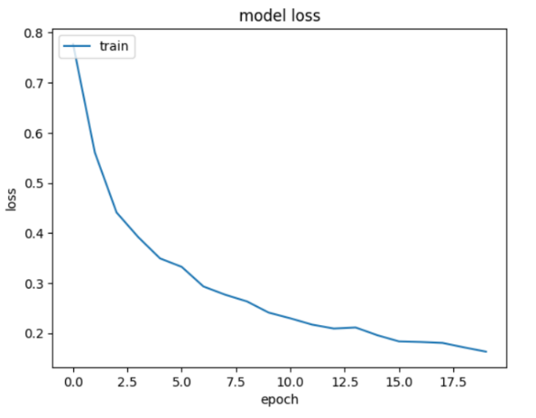
Results using RNN Model
Figure 14: Epoch v/s Model Accuracy
Figure 15: Epoch v/s Model Loss

Slide 24
Comparison Between 4 Models with accuracy and loss Results
Sl No | Decision Tree | ANN | LSTM | RNN
Accuracy | 0.99 | 0.53 | 0.93 | 0.97
Loss | 0.24 | 0.10 | 0.20 | 0.15

Slide 25
CONCLUSION
The crowd prediction project for the bus line, utilizing AI, has yielded insightful conclusions. Through the implementation of sophisticated algorithms and machine learning techniques, we have successfully forecasted crowd densities along the bus route with notable accuracy. Our model's ability to analyse various factors such as source, destination, trip, route, slot no, and other parameters has proven instrumental in generating reliable predictions.
Here we used Decision tree(99% accuracy), ANN(53%), LSTM(93%), RNN(97%) Models to get better accuracy.

Slide 26
REFERENCES
Yu Bin, William H. K. Lam, and Mei Lam Tam. 2011. Bus arrival time prediction at bus stop with multiple route. Transport. Res. Part C: Emerg. Technol. 19, 6 ( Dec. 2011), 1157–1170.
Yan Lyu, Chi-Yin Chow, Victor C. S. Lee, Joseph K. Y. Ng, Yanhua Li, and Jia Zeng. 2019. CB-planner: A bus line planning framework for customized bus systems. Transport. Res. Part C: Emerg. Technol. 101 (2019), 233–253.
Steven I-Jy Chien, Yuqing Ding, and Chienhung Wei. 2002. Dynamic bus arrival time prediction with artificial neural networks. J. Transport. Eng. 128, 5 ( Sept. 2002), 429–438.
Vikash V. Gayah, Zhengyao Yu, Jonathan S. Wood, Mineta National Transit Research Consortium, et al. 2016. Estimating uncertainty of bus arrival times and passenger occupancies. Technical Report. Mineta National Transit Research Consortium.
Taylah Hasaballah. 2019. Transit crowdedness trends from around the world, according to Google Maps. Retrieved from https://www.blog.google/products/maps/transit-crowdedness-trends-around/ (https://www.blog.google/products/maps/transit-crowdedness-trends-around/).

Slide 27
6. Zheng Li and David A. Hensher. 2013. Crowding in public transport: A review of objective and subjective measures. J. Pub. Transport. 16, 2 (2013), 6.
7. Marana, AparecidoNilceu, Marcos Antonio Cavenaghi, Roberta SpolonUlson, and F.L.Drumond."Real-time crowd density estimation using images." In International Symposium on Visual Computing, pp. 355-362. Springer, Berlin, Heidelberg, 2005.
8. Bouchafa, Samia, Didier Aubert, and Salah Bouzar. "Crowd motion estimation and motionless detection in subway corridors by image processing." In Intelligent Transportation System, 1997. ITSC'97., IEEE Conference on, pp. 332-337. IEEE, 1997.
9. Chauhan, Vandit, Santosh Kumar, and Sanjay Kumar Singh. "Human count estimation in high density crowd images and videos." In Parallel, Distributed and Grid Computing (PDGC), 2016 Fourth International Conference on, pp. 343- 347.
IEEE, 2016.
10. Muhammad Waqar Aziz1,2, Farhan Naeem3,Muhammad Hamad Alizai4, and Khan Bahadar Khan2 "Automated Solutions forCrowd Size Estimation" Reprints and permission: sagepub.com/journalsPermissions.nav DOI: 10.1177/0894439317726510.

Slide 28
THANK YOU
ANY QUESTIONS??

